Slide 1
Searching for a suitable simulation difficulty

Slide 2
Consider
Data X_{[n, p]} ϵ ℝ^{p} | n > p, p > 3
Let…
X be a simulation with:
n = 300, p = 4, k = 3 (clusters with 100 obs per cluster)
User study, 3 visual factors
Principal component analysis
Grand tour (animation of linear projections over random walk in p-space)
Radial tour (animation of linear projections moving the contribution of a single variable radial outward)

Slide 3
Hypothesis:
Does the finer control afforded by the manual tour improve the ability of the analyst to understand which variables separate clusters?

Slide 4
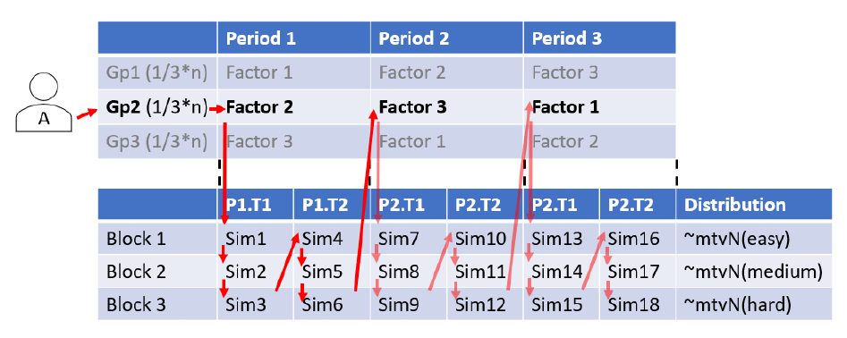

Slide 5
How do you state the question? ~~ Check all variable that are more important than average
How do you evaluate the response? ~~ sum(I(T_{p}) * (ClSep_{p} – avg)^2
Don’t want simulation difficulty to be a factor of the experiment; find a suitable difficulty.
What is suitable difficulty?
~Too difficult for PCA, not too difficult for Manual tour

Slide 6
To html file…

